Slide 1
Managing Object Creation II
IN710 OOSD 2017
Session 6.1
Notes:
Demo game first

Slide 2
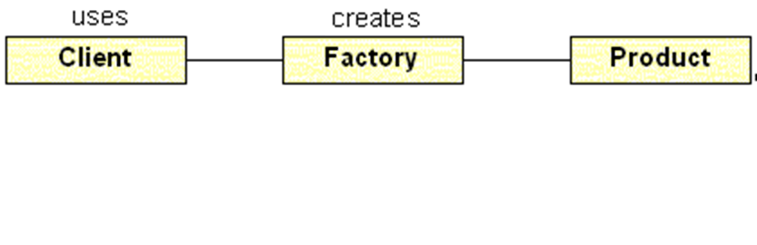
The Simple Factory
“Decoupling object use and creation by delegating the creation process to a dedicated class.”
Notes:
Last time we learned the simple factory pattern
If you ever have a class method that contains logic to create one of a number of other class instances, you should consider encapsulating that logic into its own class (a Factory).
Then, instead of peppering that logic all over the place in the consumer class, it resides only in the Factory, and the consumer class simply talks to the Factory object as needed.
Although quite useful, it is not one of the official 23 GoF patterns.
The GoF contains a number of more complex factory-based patterns, and we will see the most important one next.

Slide 3
Complex Factories
Sometimes, the object creation behaviour you want to encapsulate is more complex.
Base Class: Generates some object (common behaviour)
Child Class 1: needs concrete objects from Set 1
Child Class 2 needs concrete objects from Set 2
Child Class n: needs concrete objects from Set n
……..
Notes:
In the Mystery Door, we had one class (GameEngine) who needed to create instances from a set of objects.
But in some situations, the creation logic can be more complex.
For example, you might have a class hierarchy. Each child needs to generate some objects for some common behaviour, but the actual concrete objects needed differs from child to child.
Imagine a family of different games that use different character sets.
How will we manage our factory behaviour now?
We could make one giant factory that provided all the different objects – Child Class 1 asks for objects 0 to 5; Child Class 2 asks for objects from 6 to 10; Child Class 3 asks for objects from 11 to 15, etc.
But this is unwieldy and inelegant. Each child class is holding a factory that does a lot of work that it doesn’t need. Changes to that part of the factory’s code (that part of the switch statement) could break the child class even though it never even uses it.
It would be better to have each child class have a factory that only does the work it needs. So we have many factories that do the same job (produce characters) but implement that job in different ways (polymorphically).
Recognise this? => This is inheritance/interface ➔ We need not a single factory class, but a family of factory classes. One factory child for each class child of the main hierarchy.
Let’s look at an example…

Slide 4
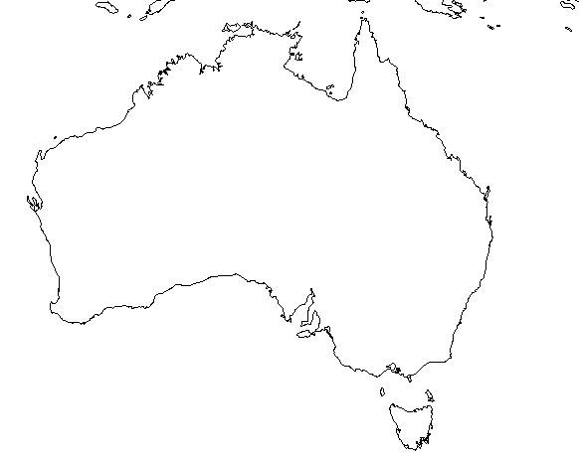
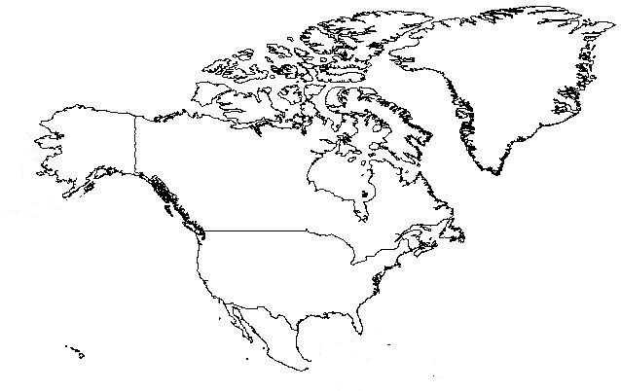
More Complex Factories
Notes:
Based on an example from dofactory.com
Let’s say that you are building some sort of zoological simulator of the type used in habitat management, or climate change prediction, or something.
For simplicity, we’ll show only North America and Australia, but of course, the architecture should scale elegantly to as many land masses as you want

Slide 5













More Complex Factories
Notes:
Each continent needs to simulate the appropriate flora and fauna.
For example, in Australia we need to create koalas, crocodiles and kangaroos
In North America, we need to create eagles, bison and wolves
The continents will have common data and behaviour, so are likely to be descendants of a common base class
The animals will have common data and behaviour, so are likely to be descendants of another common base class
Start thinking now...Keeping in mind that the purpose of the Factory approach is to decouple object use from object creation, what architecture might we use here that would be clean and scalable?

Slide 6
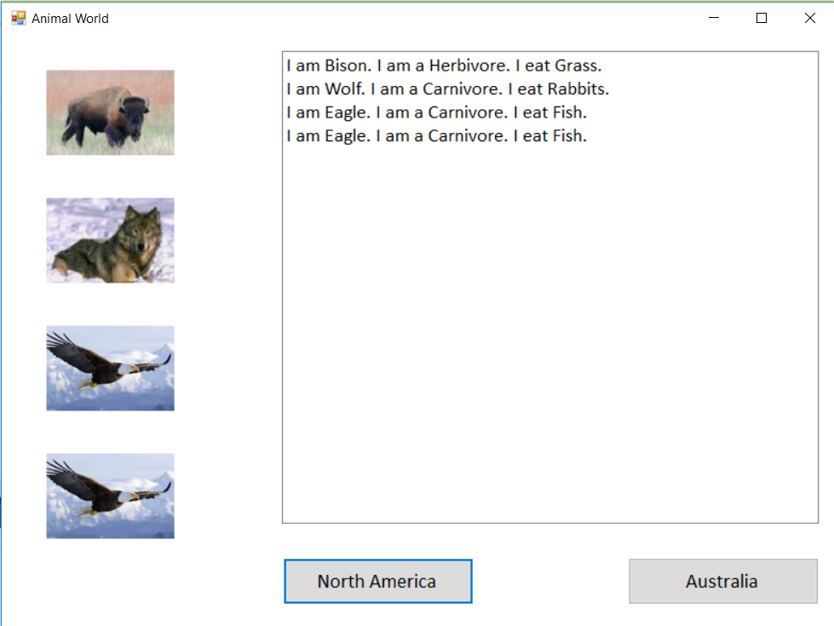
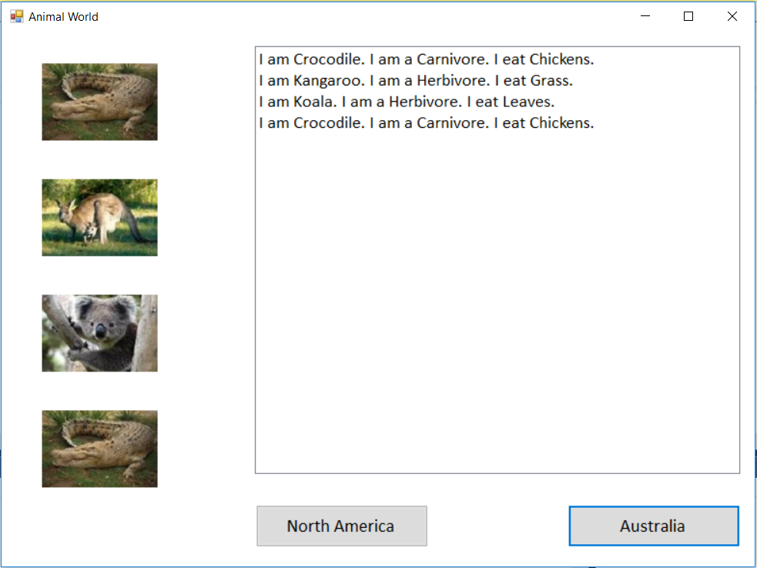
Animal World
Notes:
The actual program we will build is very, very simple in its behaviour
It just creates three randomly selected animals, then dumps their information out to a listbox and the canvas.
The architecture, of course, would be unchanged if you added more functionality, like reproduction, migration, predator-prey relationships, etc.
This behaviour of the continents is the same, so is all contained in the base class. In a real simulation, there would be additional non-common stuff.
This screen shows two snapshots of a single application – one for the NA button and one for the Australia button.
We have two continent child instances (NA and Aus). In each button, we call some sort of RunSimulation method on the corresponding concrete instance.

Slide 7
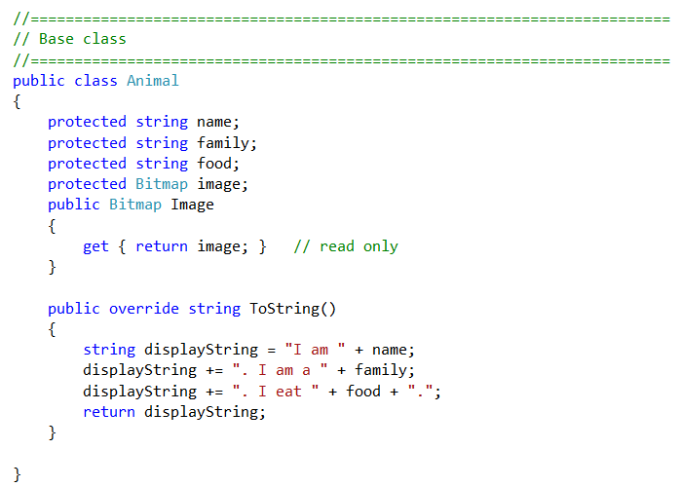
Animal World
Notes:
We’ll start with the Animal classes, because they are the simplest
For our very simple example, we might have something like this...
The base class…

Slide 8
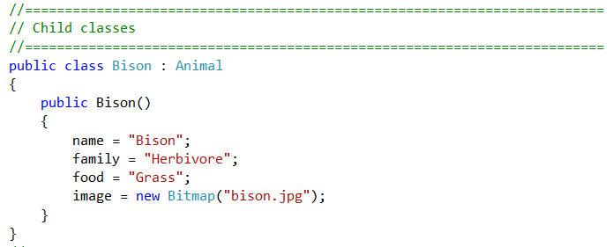
Animal World
Notes:
…and one of the animals.
Again, we note that these children actually differ only in data. In this situation we probably wouldn’t descend, as there is no polymorphism. But we are just trying to keep the functionality very simple so we can concentrate on the architecture. If it is useful to you, pretend there are hundreds of polymorphic methods in Animal hierarchy as well, we just can’t see them.
The architecture works the same no matter how fancy you made the animals

Slide 9
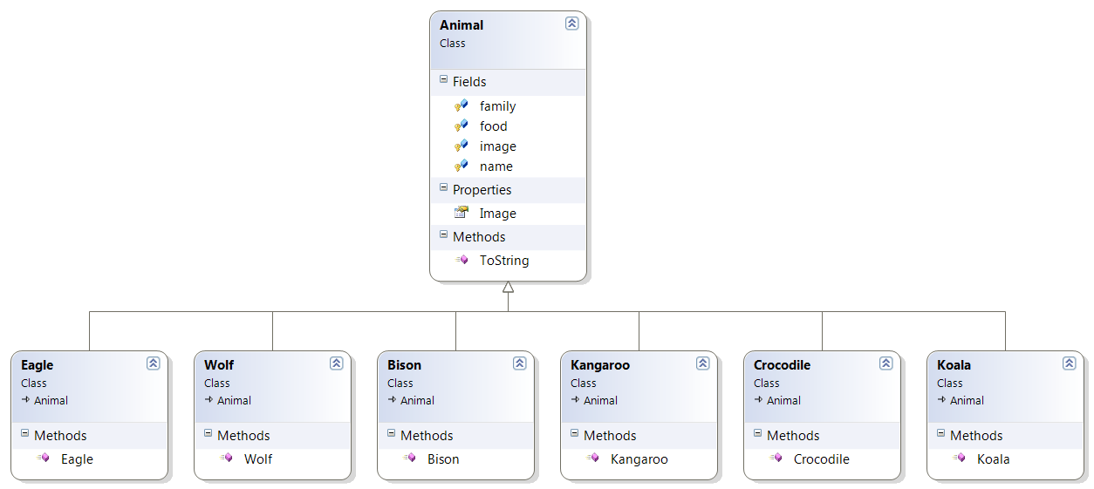
Animal World
Notes:
Put them all together into something like this
Again, in a real simulation you might have various subtrees going, but this will do for us, because all of our animals behave the same

Slide 10
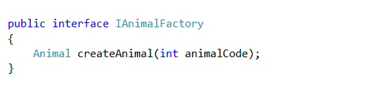
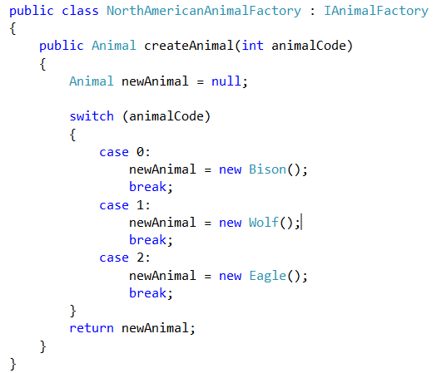
Animal World
Notes:
Next, we’ll make the factories
An animal factory is just a method, so we could sensibly make it an interface. If you need data or default methods, make an abstract class.
We could then declare two concrete factories, one for each continent.
They implement the interface, so we can use the same code in the simulator regardless of which kind of animals we make – the methods we call will be the same.
Here is the NA one. We group all the NA animals together here.
What would the Australian one look like?

Slide 11
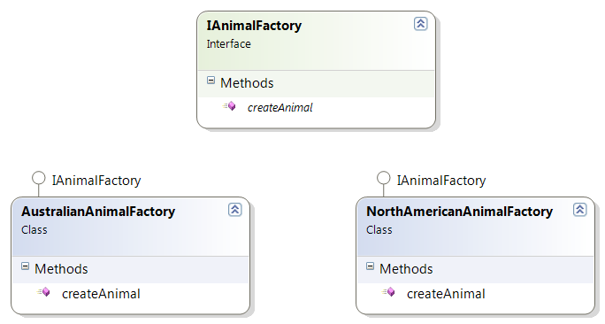
Animal World
Notes:
So the Factory hierarchy looks like this
You should see that it would be very straightforward to add additional factories for more continents

Slide 12
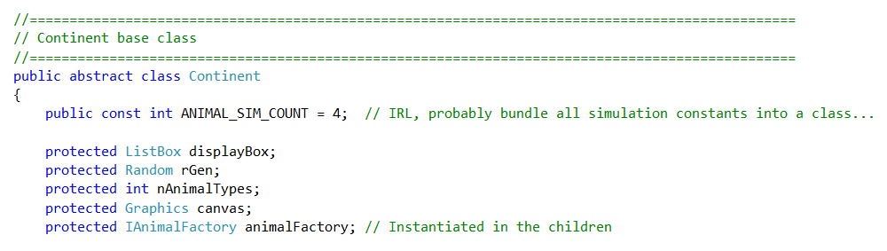
Continent Fields
Notes:
And finally, we consider the continents themselves.
They will be responsible for running the simulation, so they need the simulation parameters and controls for displaying (we allow a little UI coupling here to keep things simple – add an intermediate class to reduce this if you wish).
They will also need a factory to use to create their animals.
What is the type of the factory? ➔ IAnimalFactory (or the factory base class if you implemented as an abstract class).
Which factory do they get? ➔The one that produces the kind of animals they need
When do they get their factory object? ➔ In their constructor
If you had some kind of reason to do so (zombie alien virus plague?) and wanted to change at runtime the kind of animals that a continent produced, would it be hard? ➔ No. (so there is a sense of the strategy pattern here as well...the principles are strong...)

Slide 13
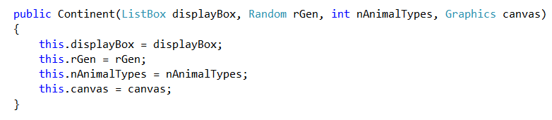
Continent Base Class Constructor
Notes:
You might want to break this apart to reduce coupling with the UI, but to make the architecture fit on the slides, we’ll tolerate it here.

Slide 14
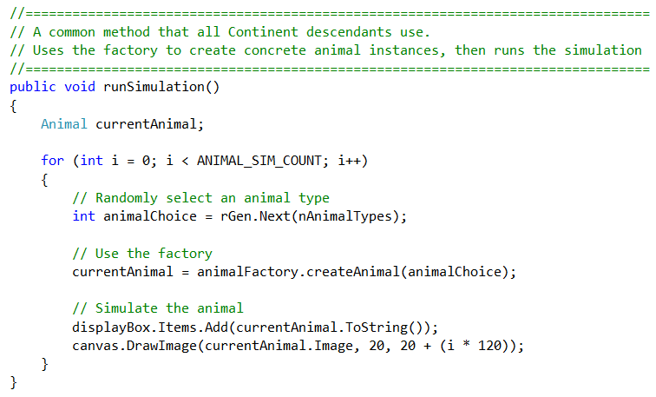
Continent Base Class Method
Notes:
This is the common method to run the simulation – in the continent base class.
Note that there is no need for polymorphism here. As long as each continent descendant class gets the right kind of factory in its constructor, the code is identical for all descendants.
Isn’t that lovely. Note the complete absence of code duplication.
IRL, those constants would come from some configuration object…

Slide 15
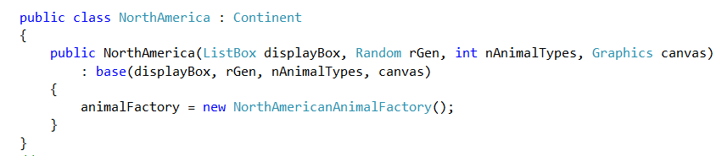
Continent Descendant
Notes:
So, what does the concrete continent child class look like?
In its constructor, it calls the parent to get the common code, then initialises its factory.
Since it makes the correct factory, runSimulation will create the correct kinds of animals
Like magic.
Australia is left as an exercise

Slide 16
Animal World Factory
Form code
Notes:
Exercise in practical
One thing you will notice is that there is very little code in the form.
Basically you create your continents, and, in the appropriate button click handler, you tell a continent instance to execute its runSimulation method.
Again we see this very common pattern in OO of lots of code underneath, and by the time we get to the upper management, it’s just a simple method call.

Slide 17
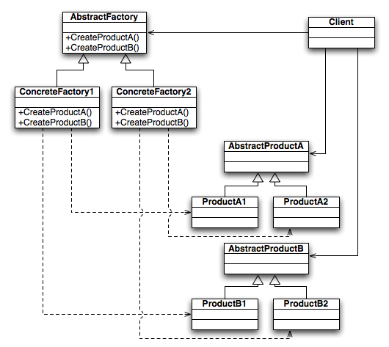
Abstract Factory Pattern
Notes:
The pattern we just made is an example of the “Abstract Factory Pattern”
A family of consumers and a family of factories.
You have an abstract factory (our interface), and appropriate concrete implementations of it
Here is the official diagram for the Abstract Factory Pattern.
These sorts of diagrams are often presented for the design patterns.
The solid lines are “needs” or “uses” (i.e. composition or aggregation).
The dotted lines are “creates”.
The hollow arrows are inheritance, like always.
Sometimes, reading the diagram is harder than writing the code…
So you have a Client that needs one or more products (In our example, Continents = Client, Animals = Product)
Here called Products A and B; there could of course be more.
In our example, we only made one kind of product. What would change if we wanted to make more products? ➔ The number of methods in the Factory interface.
We might have, for example, createAnimals and createPlants
Instead of creating the products itself by calling new directly, the client uses a factory – a member of the factory family.
The client gets a concrete factory (a class that implements the interface or abstract base class) which creates concrete instances of the products that it needs.
In practical, we will build several examples using the Abstract Factory Pattern.

Slide 18
Main Theoretical Point
Decoupling object creation from object use is a powerful technique that supports code flexibility and reuse.

Slide 19
Practical
Due next Tuesday
No new material in class on Thursday
Notes:
Just work time. Optional.

